Slide 1




Zero-Knowledge Proof

Slide 2
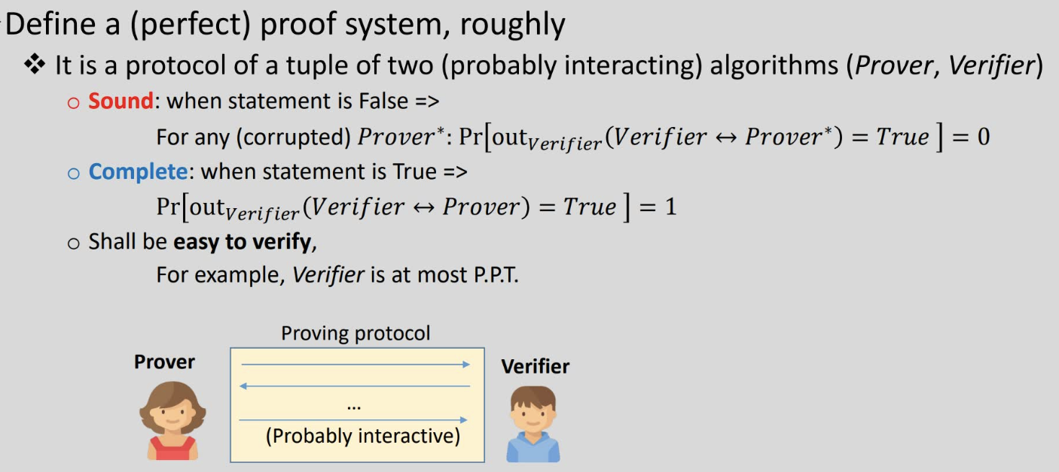
What is Proof?

Slide 3
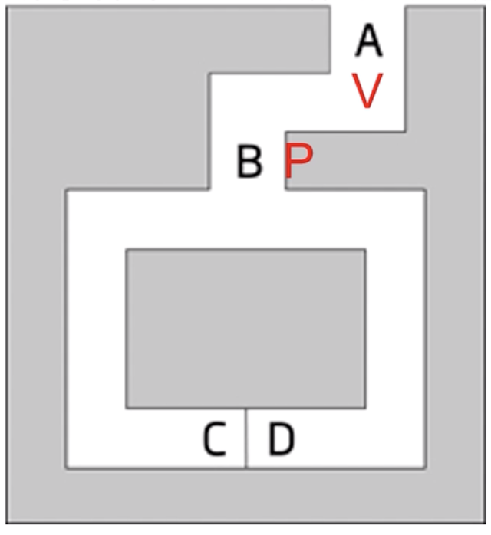
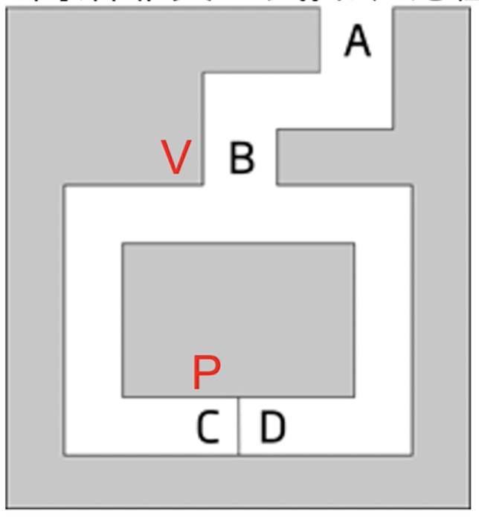
Zero-Knowledge

Slide 4
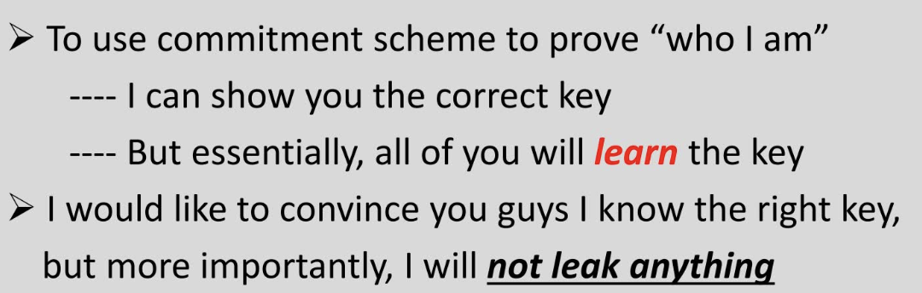
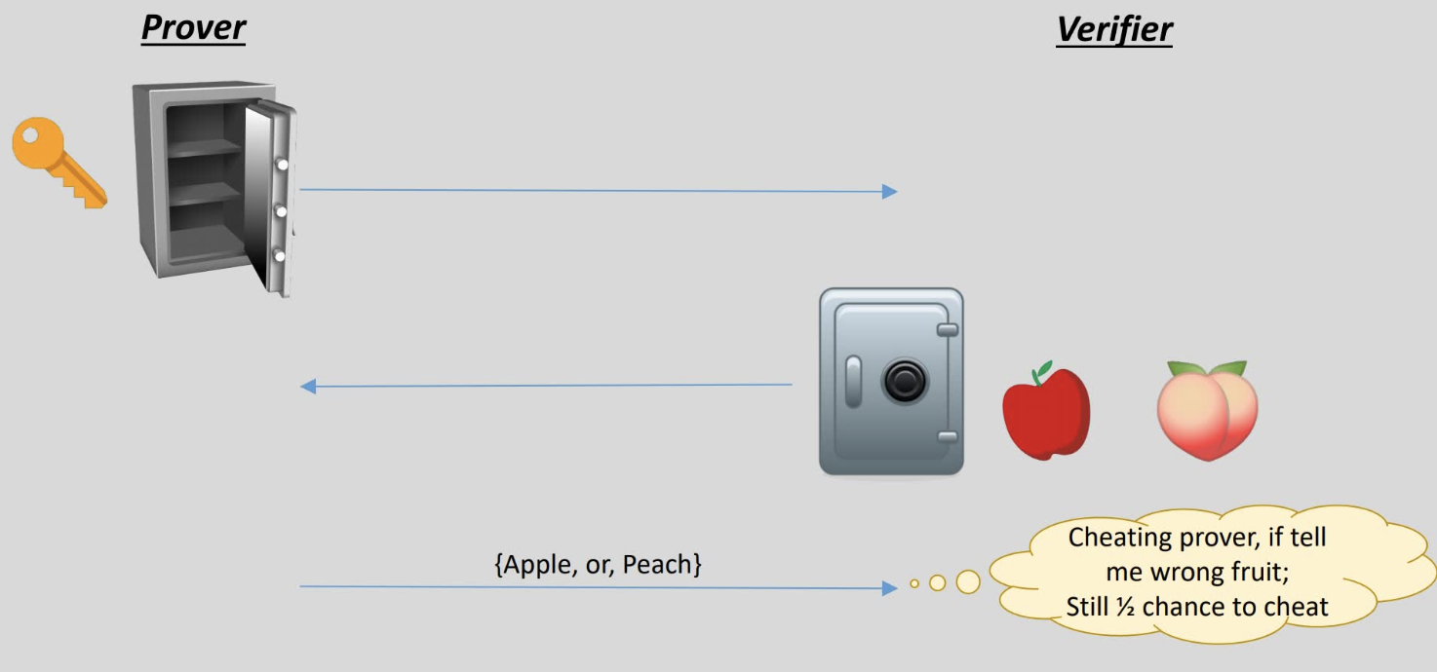
Zero-Knowledge Example

Slide 5
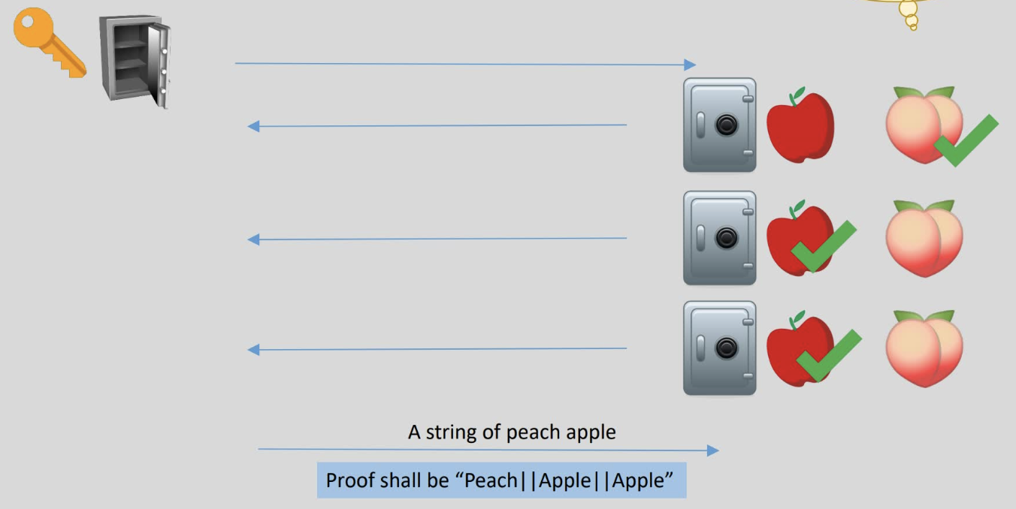
To prove Or to cheat

Slide 6
Application Scenarios
Proof
Authentication (login)
Prove I am a registered user
Verifiable computing
Cloud proves it computes a function correctly
Verifiable data integrity
A picture is not PS-ed
Blockchain lightweight client
Zero-knowledge proof
Anonymous authentication (login)
Prove I am a registered user, but not tell you anything leaking my identity
Confidential cryptocurrency
Hide blockchain transactions
Private smart contract

Slide 7
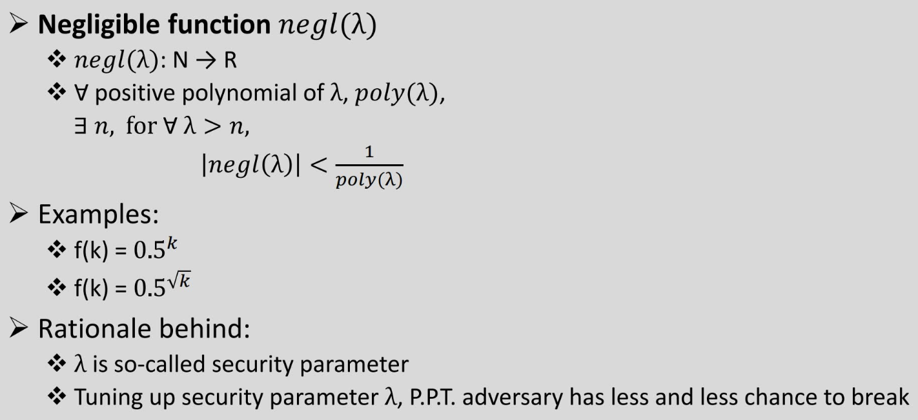
Some other notations (1/3)

Slide 8
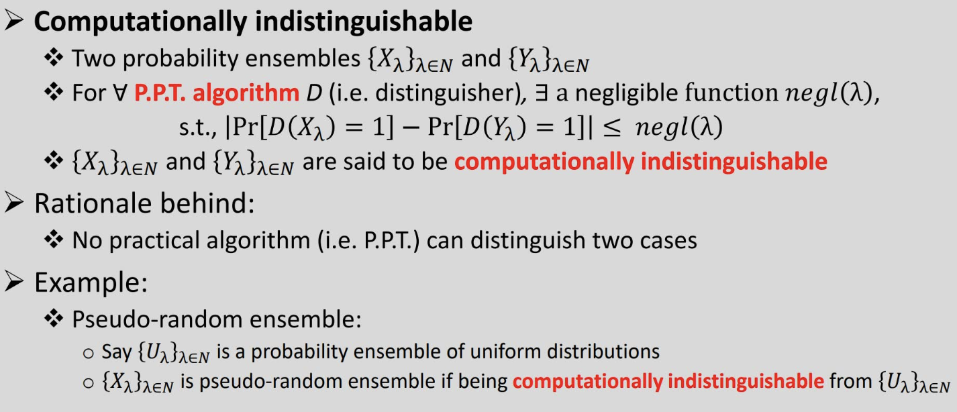
Some other notations (2/3)

Slide 9
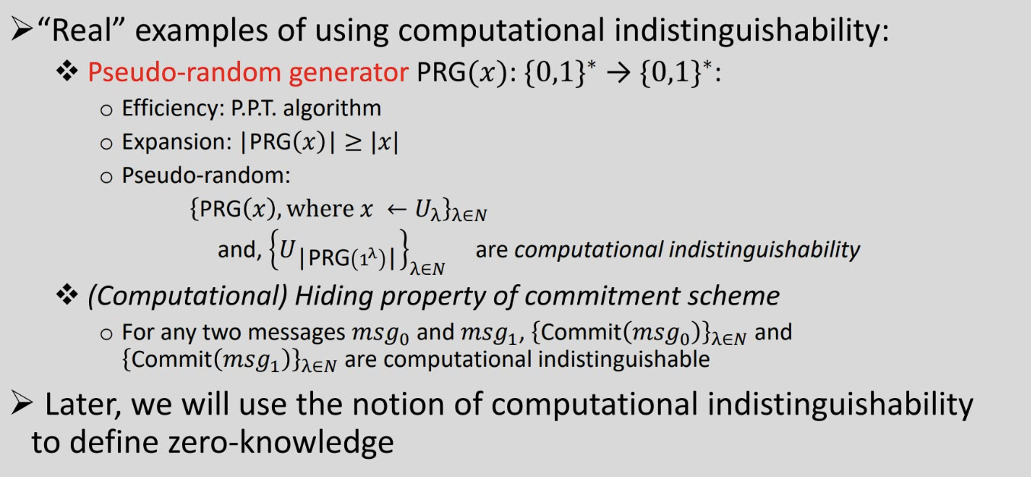
Some other notations (3/3)

Slide 10
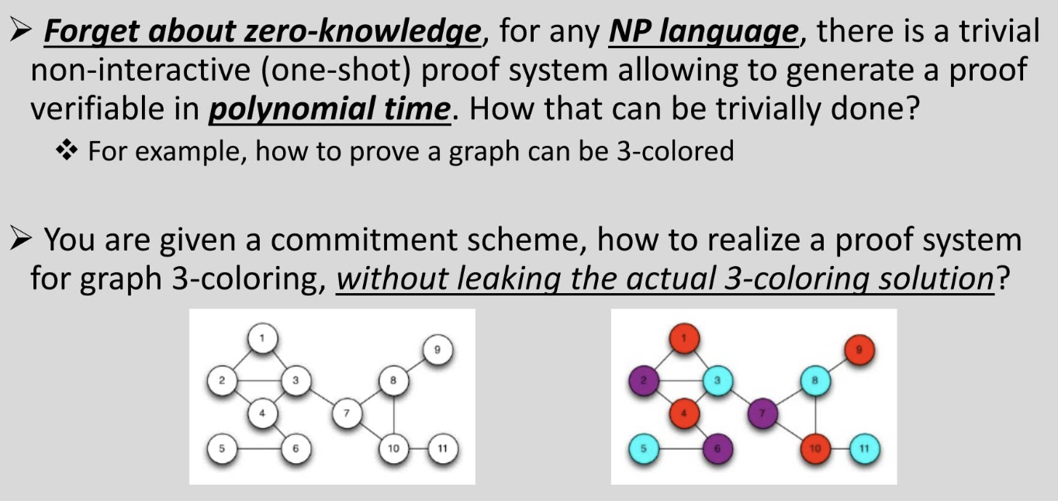
Questions

Slide 11
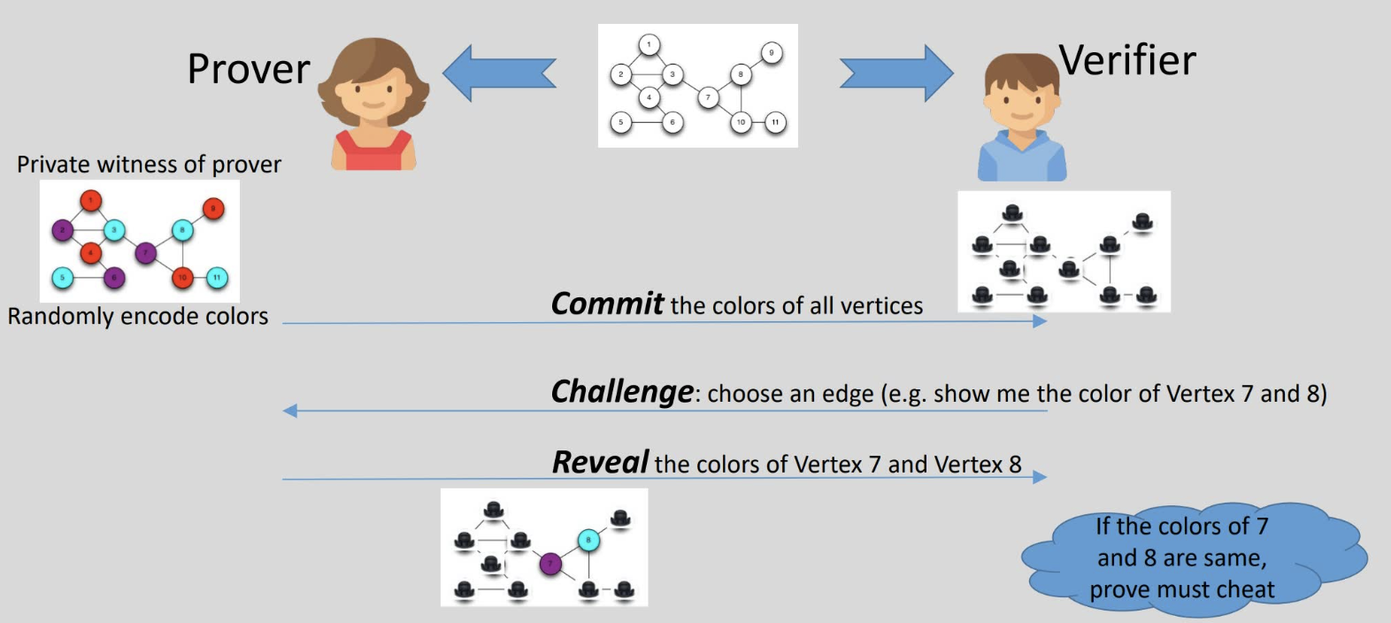
Three coloring

Slide 12
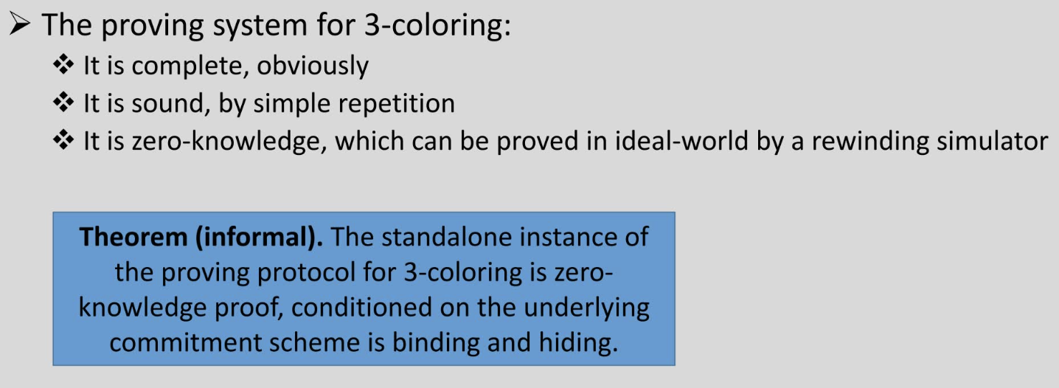
Three coloring

Slide 13
Project Scope
Investigation on different types of cipher
including One-time Pad, Stream Cipher, Block Cipher
Investigation on encryption algos
including DES, AES, RSA, PKE, SKE, cryptographic hashes, Diffie-Hellman Ratchet, Double ratchet
Investigation on key exchange approaches
including Diffie-Hellman, PKI and SSL/TLS
Investigation on basic Zero-Knowledge proof algo with scenarios:
ZKP of discrete log
ZKP of 3-coloring
Non-Interactive ZKP
Blind Signature

Slide 14
Project Scope con’d
Investigation on three improved ZKP algos:
three new strongly deniable key exchange protocols—DAKEZ, ZDH, and XZDH
DAKEZ: DAKE with Zero-knowledge
ZDH: Zero-knowledge Diffie-Hellman
XZDH: eXtended Zero-knowledge Diffie-Hellman
Initial implementation of DAKEZ (not fully finished)
Tests
Final Report

